Slide 1
VSS
Mobile Sales System

Slide 2
Modules and Features
Device (PDA – Android)
Customer Master
Supplier Master
Product Master
Sales
Location verification
Daily sales Statements
Multiple Invoice Templates
Automatic and Manual Data synchronization
Web Console
Customer Master
Supplier Master
Product Master
Device Configuration
Location verification
Device Monitoring(Geo-Map)
Sales Reports(5 – Customizable reports)

Slide 3

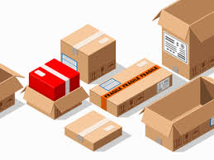
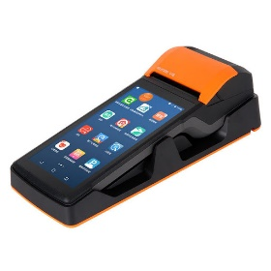
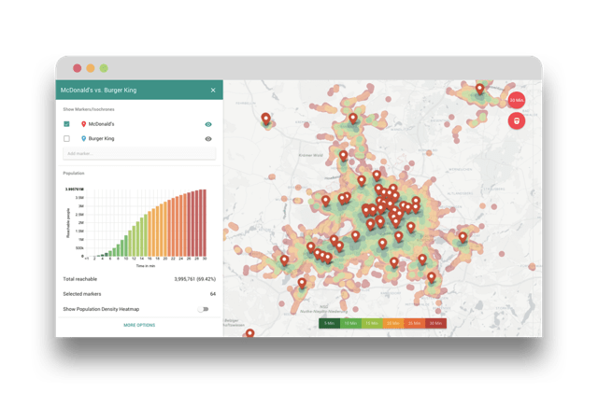

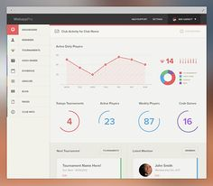
VSS Process
Step 1: Upload/Create
product masters
Step 2:Sync Master data to deivce
Step 3: Sales Transaction
Step 4: Automatic/Manual Data sync from device to server
Step 6:
The Result
Step 5: Web console

